Slide 1
PBM Payment Hold Release — /cvs + /v1
REST-only. /cvs = CVS (existing); /v1 = Aetna (new proxy/BFF).

Slide 2
Executive Summary
Members release PBM mail-order Payment Holds from the portal
Transport: REST only; No new CVS endpoints
Routing
Portal → Aetna /v1 → CVS /cvs (Experience API)
Flow: Eligibility → Consent → Resolve → Refresh

Slide 3
Endpoint Map (Ownership)
Aetna /v1 (new)
GET /v1/high-cost-hold?rxId&memberId
POST /v1/payment-consent
POST /v1/orders/{orderId}/resolve-payment-hold
GET /v1/orders/{orderId}
Headers: Idempotency-Key (POST), X-Trace-Id
CVS /cvs (existing)
GET /cvs/high-cost-hold?rxId&memberId
POST /cvs/payment-consent
POST /cvs/orders/{orderId}/resolve-payment-hold
GET /cvs/orders/{orderId}
Auth: OAuth2 client credentials

Slide 4
End-to-End (Happy Path)
1) GET /v1/high-cost-hold?rxId&memberId → ELIGIBLE (reason=54)
2) POST /v1/payment-consent → consentReference
3) POST /v1/orders/{orderId}/resolve-payment-hold → released + auditId
4) GET /v1/orders/{orderId} → holds cleared; cache purge + audit

Slide 5
Example — /v1 Calls
GET /v1/high-cost-hold?rxId=RX123&memberId=M-12345
POST /v1/payment-consent
{ "orderId":"ORD-10001","rx":[{"rxNumber":"1234567","consentResponse":"Y"}],
"paymentInstrument":{"token":"pm_..."},"memberId":"M-12345","traceId":"TRACE-..." }
→ { "status":"accepted","consentReference":"CONS-9f2c3" }
POST /v1/orders/ORD-10001/resolve-payment-hold
{ "rx":[{"rxNumber":"1234567"}],"memberId":"M-12345","consentReference":"CONS-9f2c3","traceId":"TRACE-..." }
→ { "result":"released","auditId":"AUD-20251010-001" }

Slide 6
Forwarded — /cvs Calls
GET /cvs/high-cost-hold?rxId=RX123&memberId=M-12345
POST /cvs/payment-consent
POST /cvs/orders/ORD-10001/resolve-payment-hold
GET /cvs/orders/ORD-10001

Slide 7
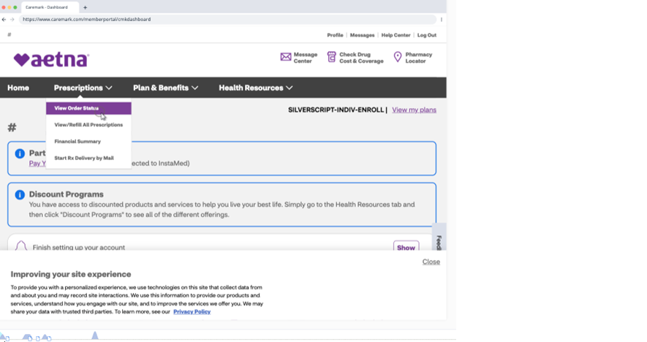
UI Flow
1/4 Orders list — context. Delayed card appears when eligible; next → details.

Slide 8
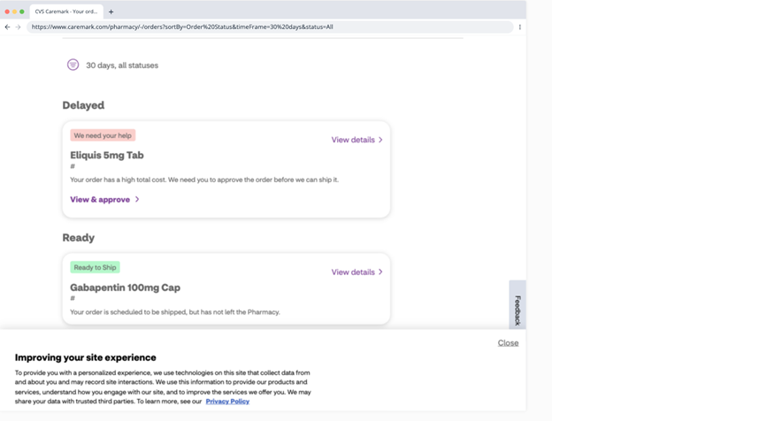
UI Flow
2/4 Order details — 'We need your help' → maps to /v1/high-cost-hold ELIGIBLE (reason=54).

Slide 9
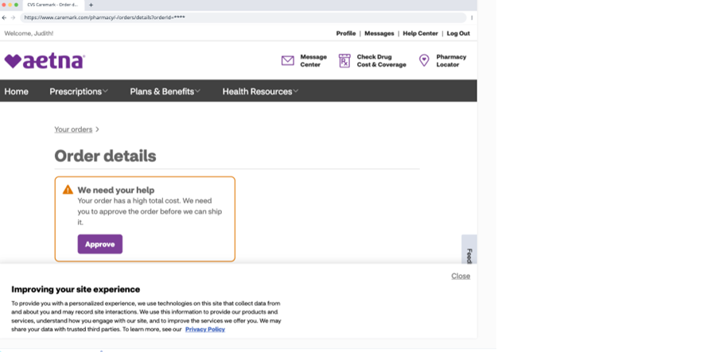
UI Flow
3/4 Delayed card — 'View & approve' → consent capture then POST /v1/payment-consent.

Slide 10
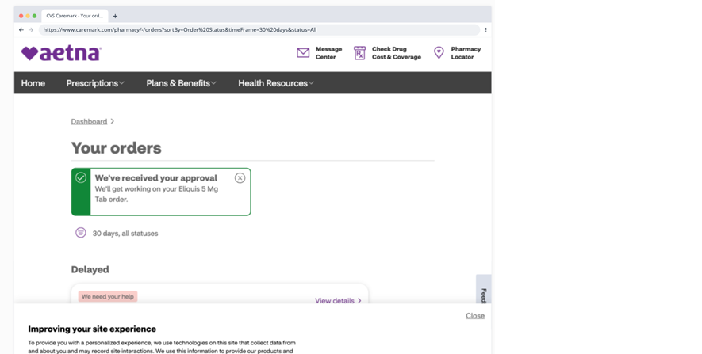
UI Flow
4/4 Dashboard nav — entry to 'View Order Status' returning into this same flow.

